Slide 1
DISTRIBUTED STORAGE SYSTEM
Guide :
Prof. Mrs. Laura Thiele
Prof. Mr. Sascha Bosse
Prof. Mr. Pohl
Abhijith Remesh - 221424 Baizil Mulakkampilly - 221544

Slide 2
Table of Contents
Problem Definition
Requirements
Hardware components and Software utilities
Architecture
High level
Detail level
Communication flow
Design
Use case diagram 1
Use case diagram 2
Activity diagram 1
Activity diagram 2
Implementation
MySQL databases
Node-RED flows at the Raspberrypi &local machine
Testing - Article error detection techniques
Method I & II
KNN & Decision tree classifier
Deployment
Prospects
Scalability approaches I & II

Slide 3
Problem Definition
Manufacturing Companies now tend to automate and digitalize their enterprise and production processes.
Digital integration of production facilities enables to get new information and useful knowledge about their processes in real time.
Development of a software system for the management of inventory levels which follows a distributed storage architecture to enable high flexibility and scalability to the inventory management system.
Warehouse components to be represented as corresponding software components which can be integrated into the software system.

Slide 4
Requirements
Interfacing the scaling device with raspberry pi and parsing the data in specific data formats.
Development of database containing the feature information of warehouse components
Developing the logic to identify the counts of warehouse components accurately based on weight comparison.
Setting up real time MQTT communication between the Raspberry Pi and the local machine.
Implementing the dashboard to view the inventory levels of each warehouse component.
Developing the user interface facility to add new warehouse component, select a component and delete an existing component.
Development of a database for storing the inventory log information.
Storing the inventory log information into the database as per user input.
Utility to delete and download the inventory log information on user input.
Several approaches to identify article weight mismatch.

Slide 5


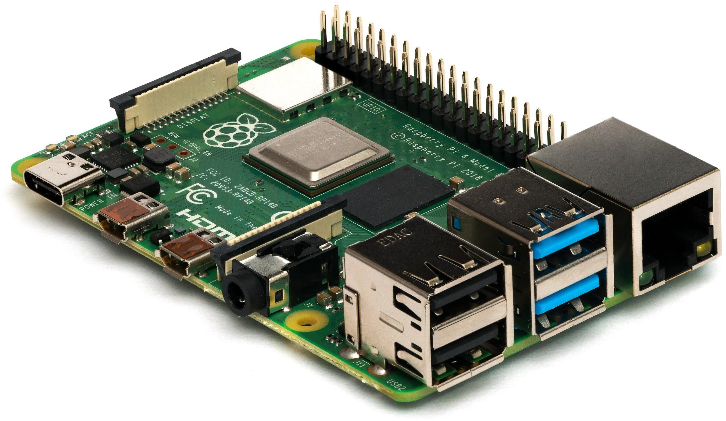


Hardware and Software utilities

Slide 6
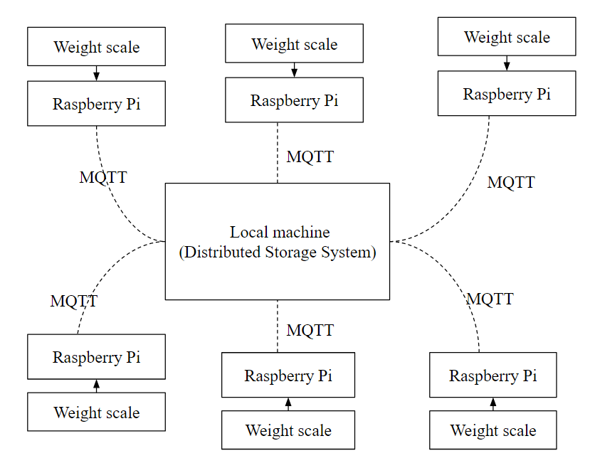
Architecture - High Level (Abstract)

Slide 7
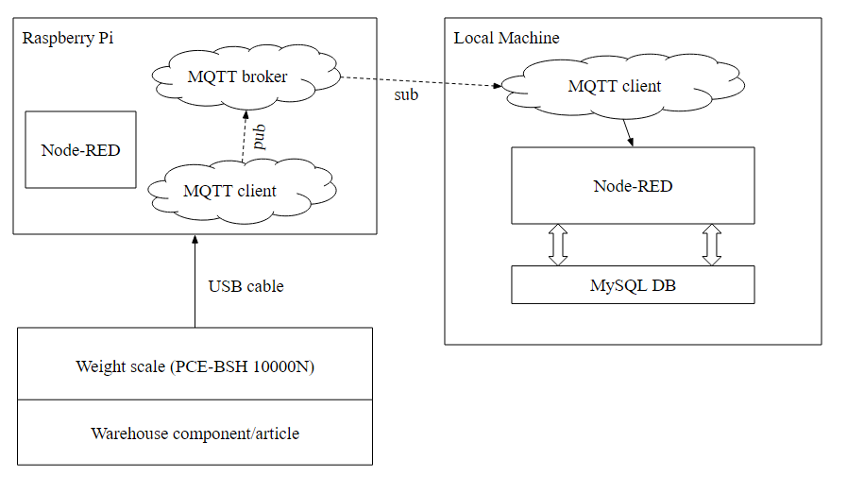
Architecture - Detail level

Slide 8
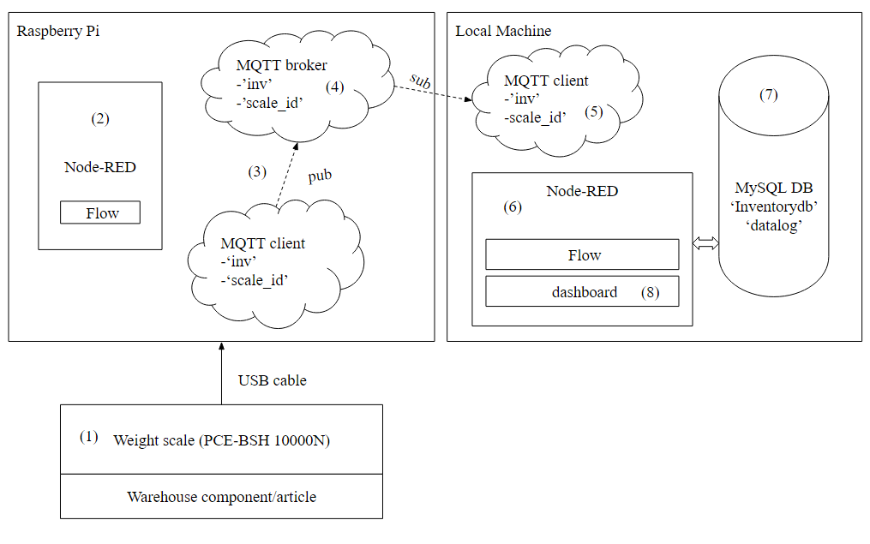
Architecture - Communication flow

Slide 9
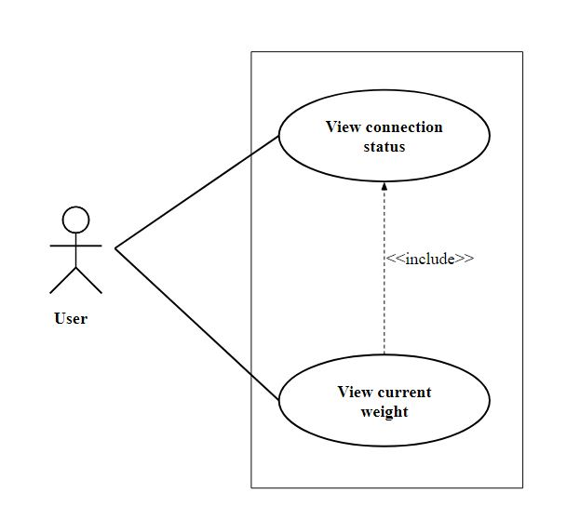
Design - Use Case diagram 1

Slide 10
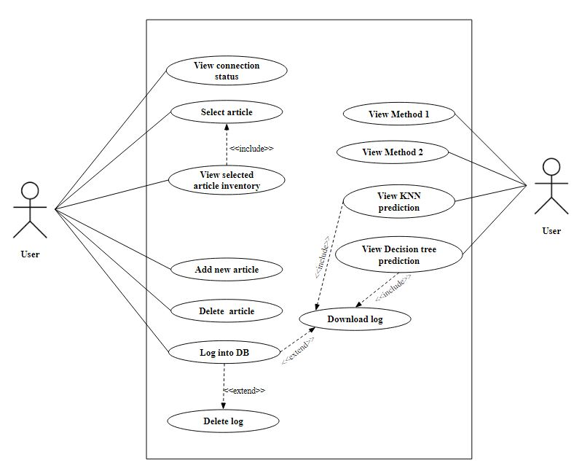
Design - Use Case diagram 2

Slide 11
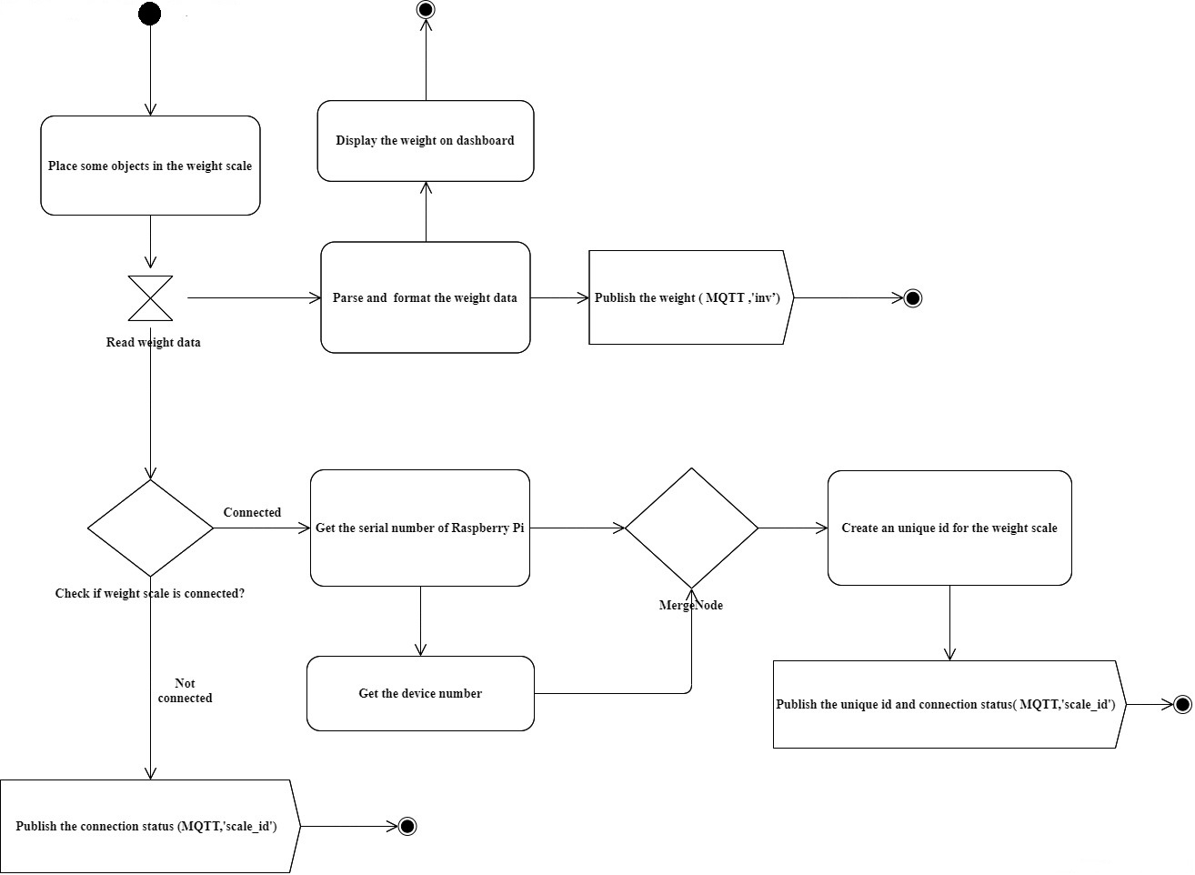
Design - Activity diagram 1

Slide 12
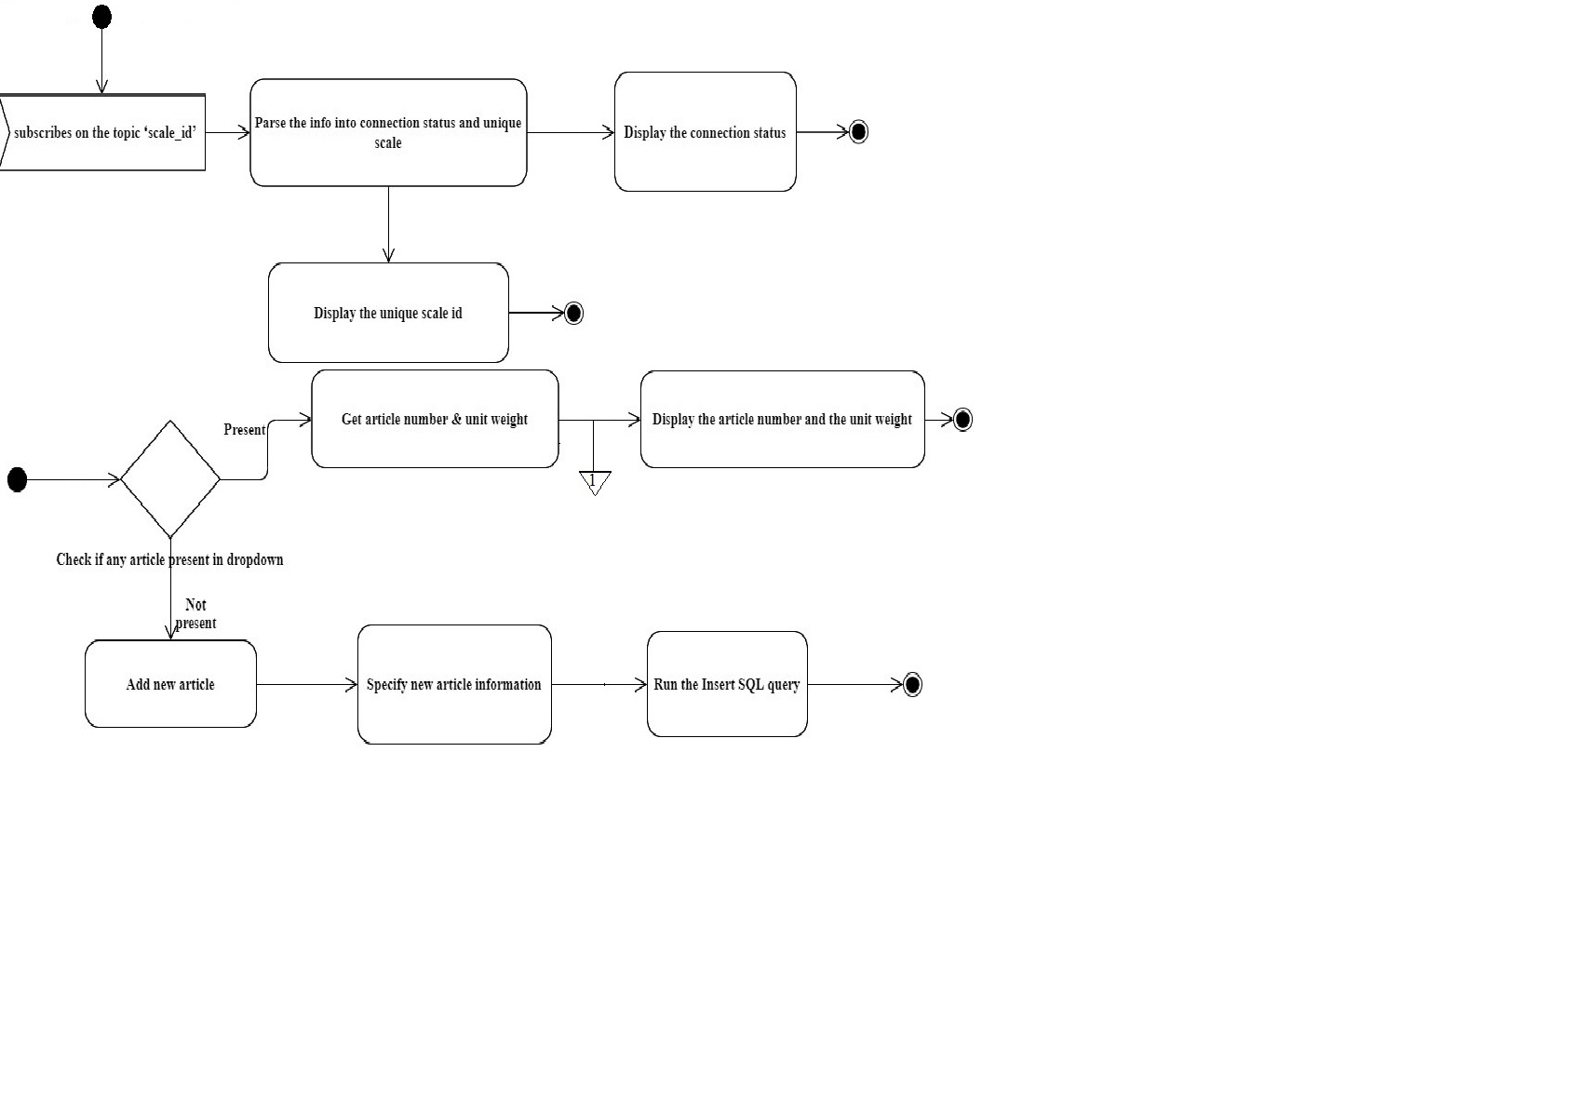
Design - Activity diagram 2.1

Slide 13
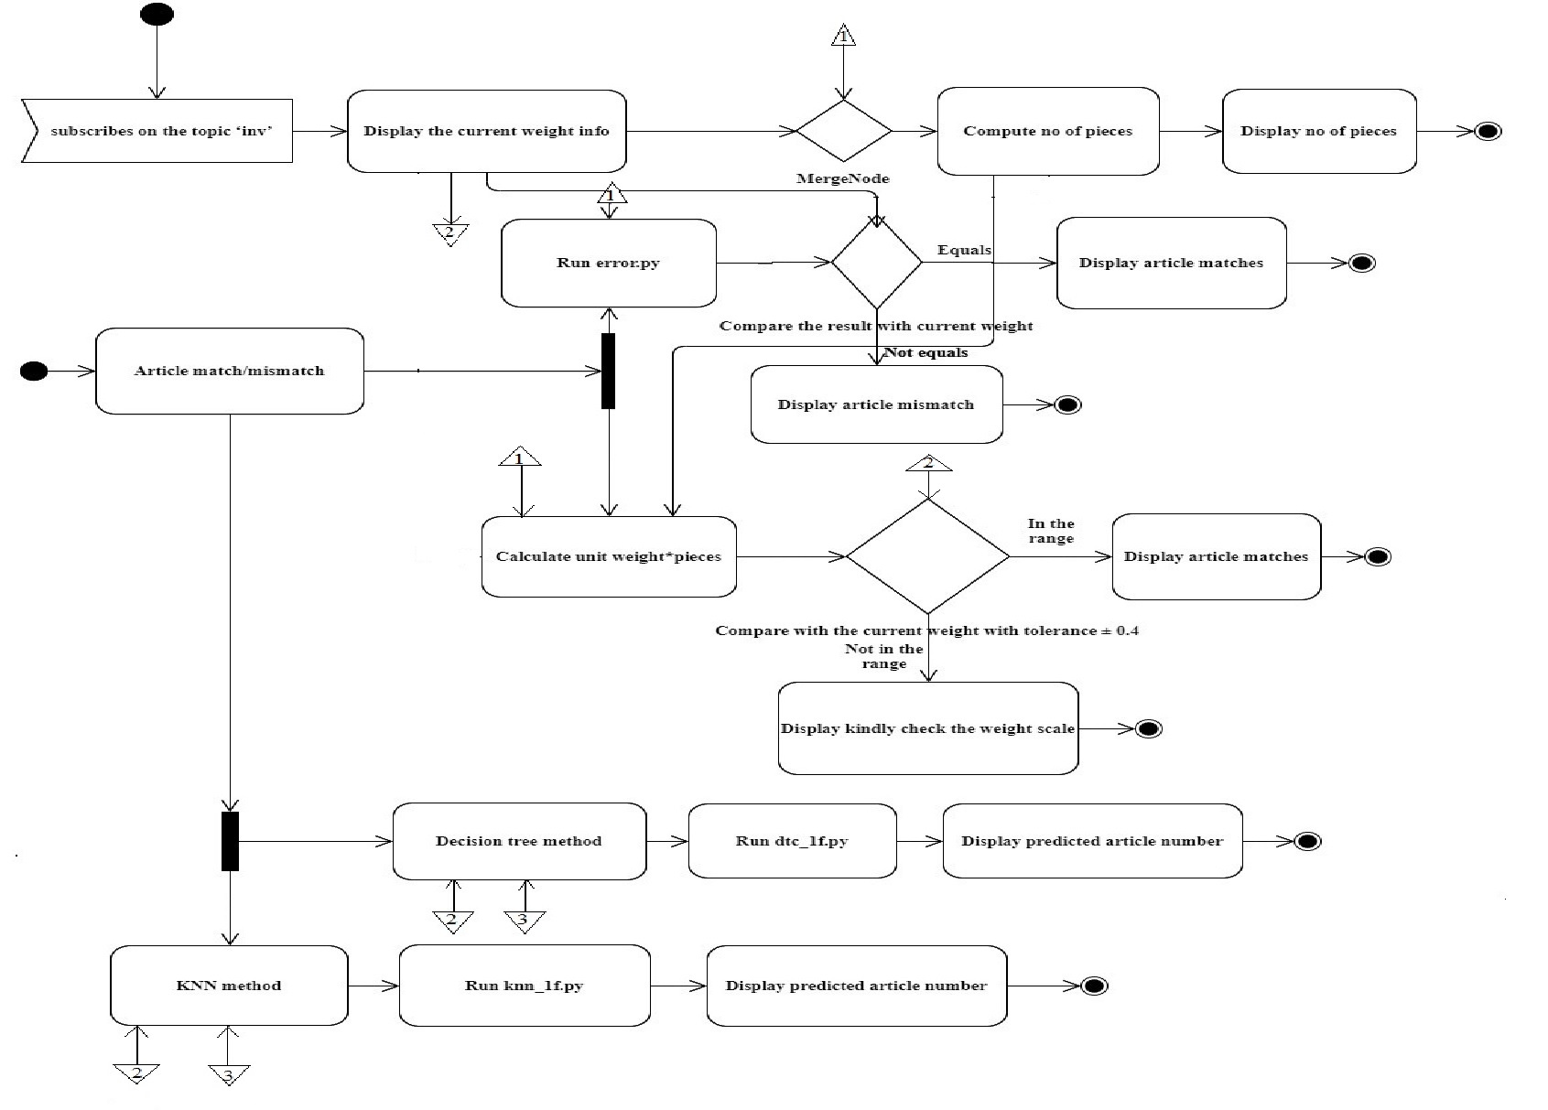
Design - Activity diagram 2.2

Slide 14
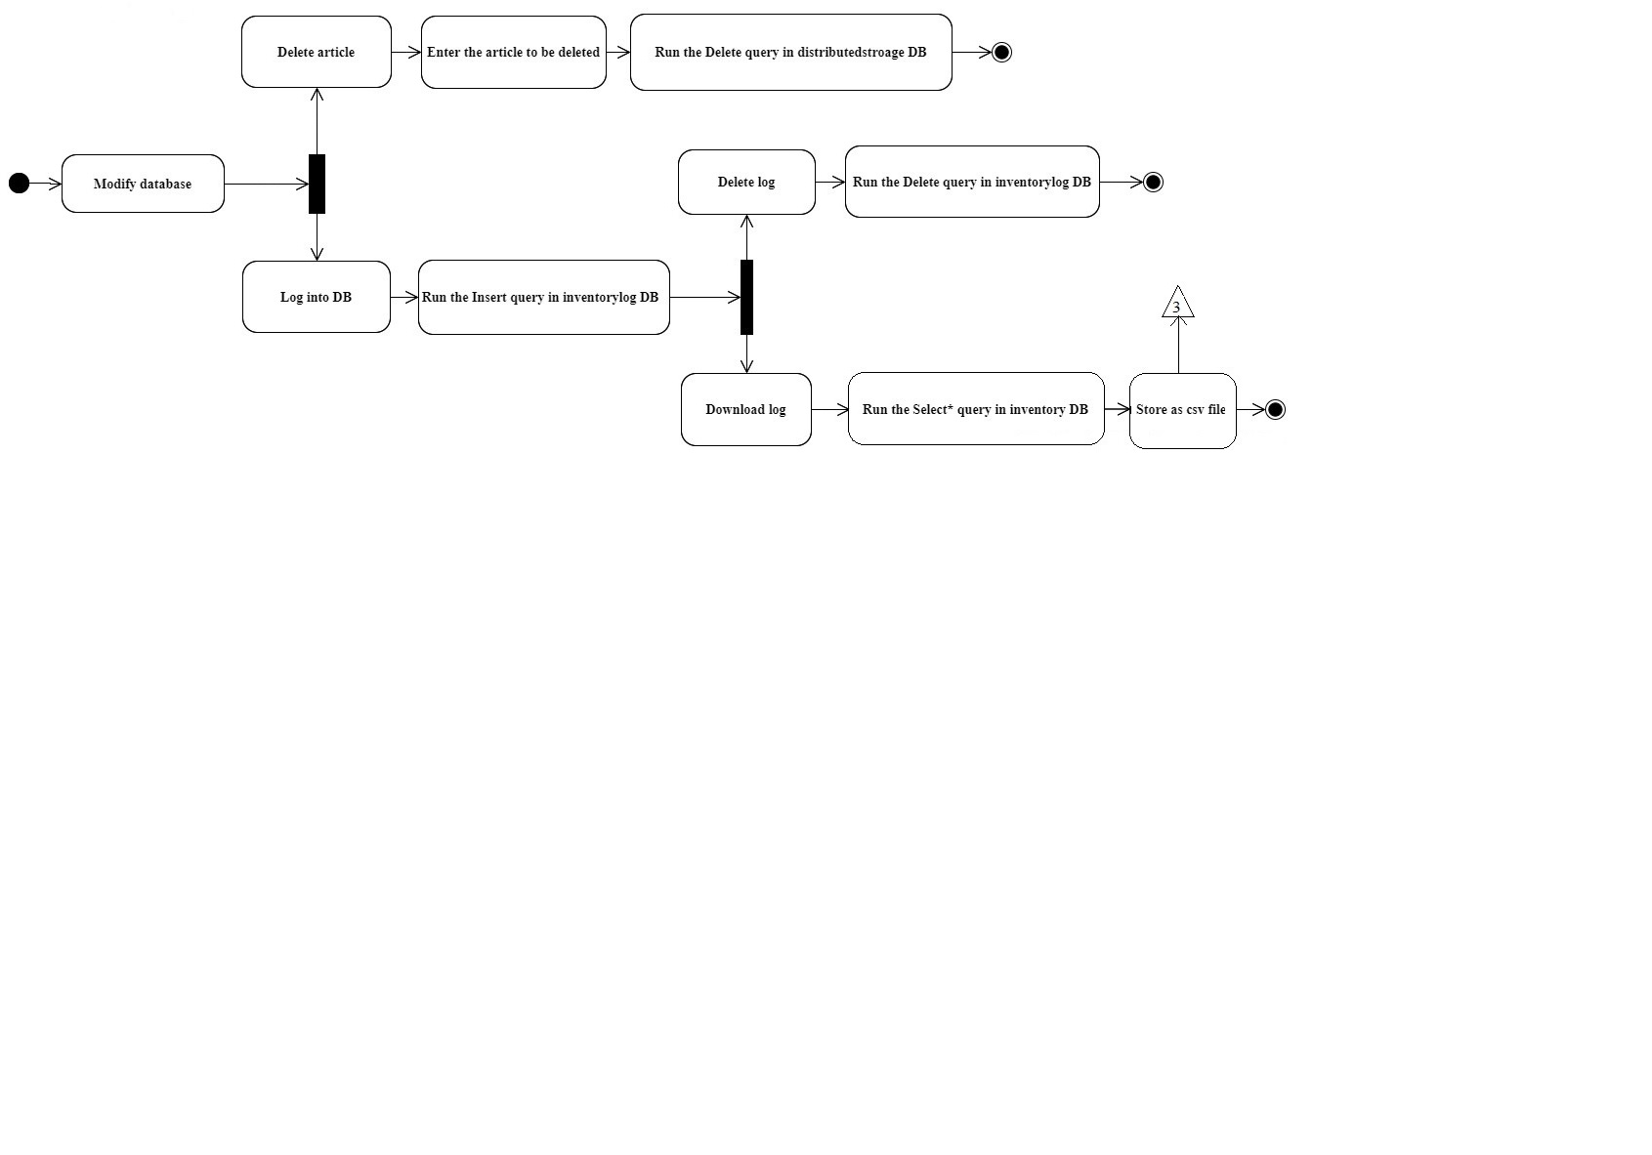
Design - Activity diagram 2.3

Slide 15

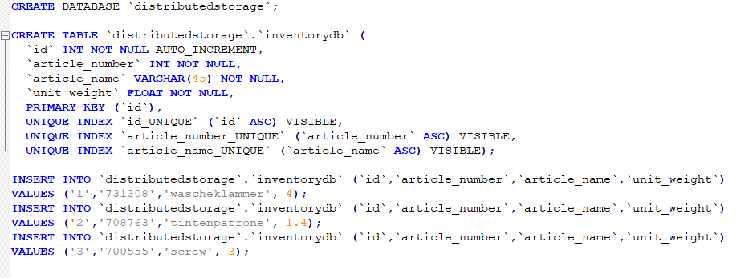
Implementation - MySQL databases
id | article_number | article_name | unit_weight
1 | 731308 | Waschenklammer | 4g
2 | 708763 | Tintenpatrone | 1.4g
3 | 700555 | Screws | 3g
Database: distributedstorage
table ‘inventorydb’
to store the master data of warehouse components
can also add new article details through the dashboard.

Slide 16
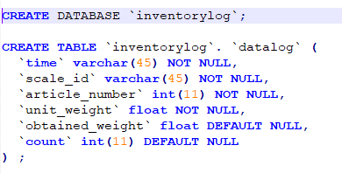
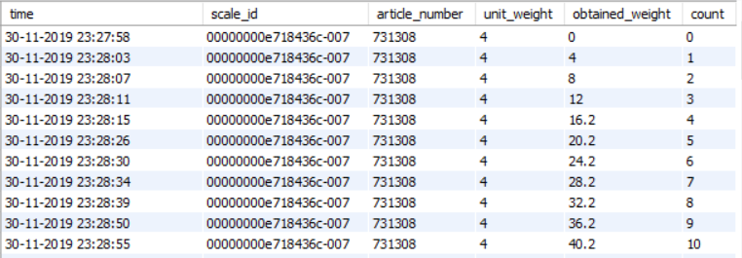
Implementation - MySQL databases
time | scale_id | article_number | unit_weight | obtained_weight | count
Database: inventorylog
table: datalog
to store the timestamped log information of all the warehouse articles being kept on the weight scale on user demand - transactional data.
can also download, delete the log information on user demand.

Slide 17
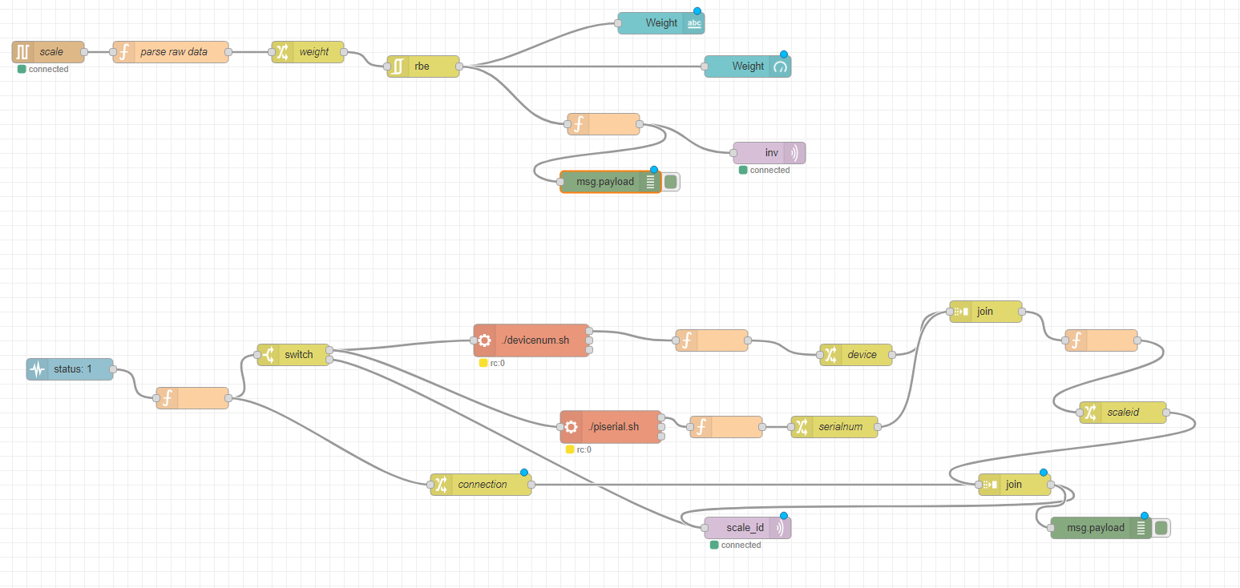
Implementation - Node-RED flow at Raspberry Pi

Slide 18
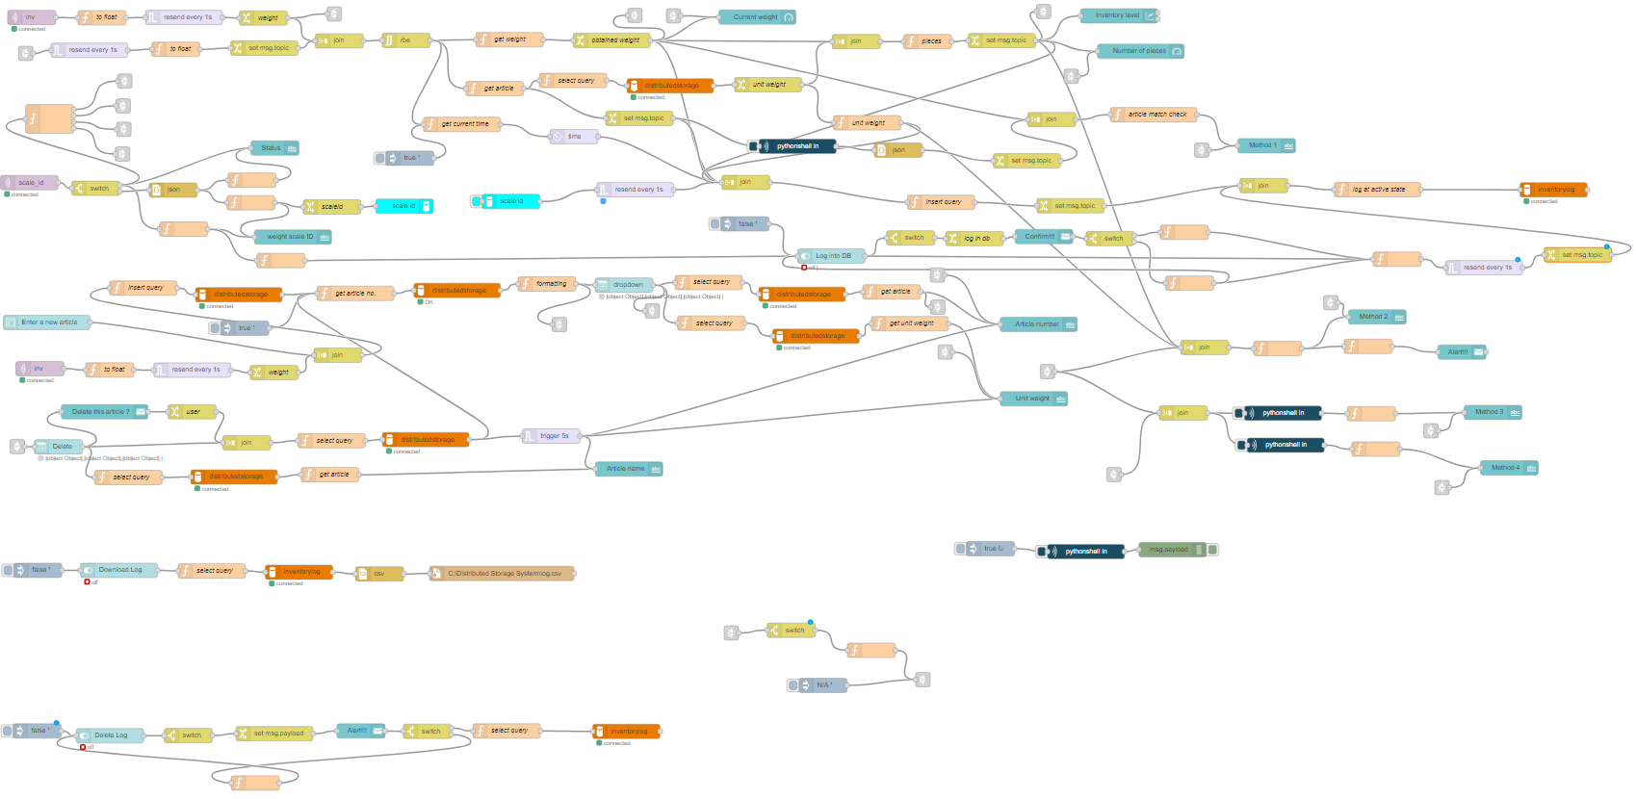
Implementation - Node-RED flow at local machine

Slide 19
Testing - Error detection techniques
Method I
Method II
K Nearest Neighbour
Decision Tree classifier

Slide 20
Testing - Error detection techniques - Method I & II
Method 1
checks if the obtained weight detected in real time from the weight scale lies within the permissible set of estimated weight values for that specific article.
Gets the unit weight and computes the permissible range of weight values based on unit weight
If unit weight of a article = x g
Obtained weight values = multiples of x ± t. ( t is tolerance)
Permissible range = [x ± (t-0), x ± (t-1), x ± (t-2), x ± (t-….t), x ± (t-t), 2x ± t ]
Method II
takes into account the obtained weight (ow) in real time from the Raspberry Pi, the number of pieces information (p) and the unit weight (uw) of the selected article.
ow == (p * uw) ± t
If Equation does not satisfy, then Article mismatch
If Equation satisfies, then Article match.

Slide 21
Testing - Error detection techniques - KNN & Decision tree classifier 1
Both the models predicts the article number when an article is placed on the weight scale.
log.csv as the source file used for training.
The features like time, scale_id, unit_weight, count dropped being irrelevant.
The feature ‘obtained_weight’ as the only input to the models.
The feature ‘article_number’ as the class label.
75 percent of this data for training and 25 percent for testing both the models.
Training of the models scheduled weekly ( every 168 hours).
The trained models predicts the article number whenever the obtained weight parameter is passed as the input to the model ie, whenever an article is placed on the weight scale.
time | scale_id | article_number | unit_weight | obtained_weight | count
obtained_weight | article_number

Slide 22
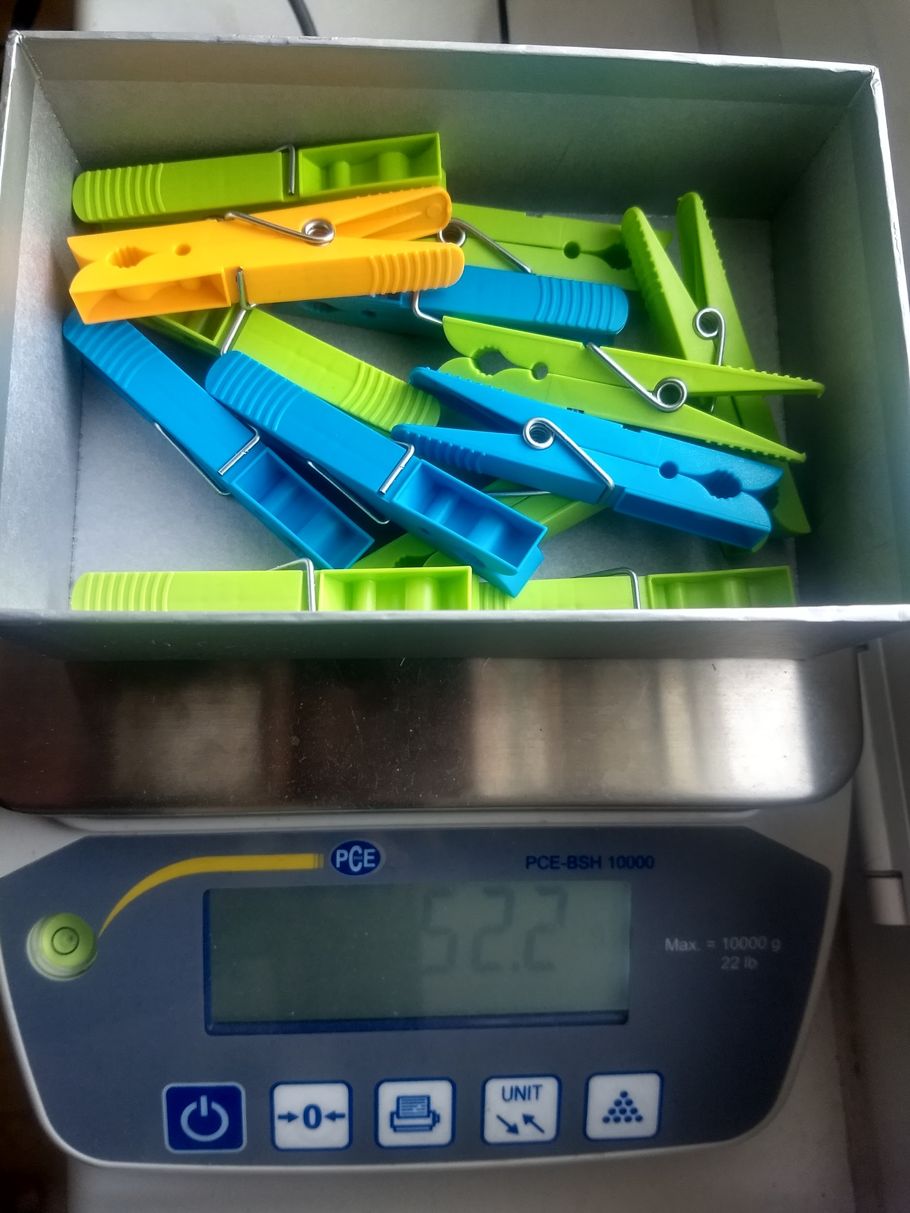
Deployment - weight scale reading
Article - waschenklammer placed on the weight scale
13 pieces
unit weight: 4g
Article number: 731308
Weight scale showing ‘52.2g’

Slide 23
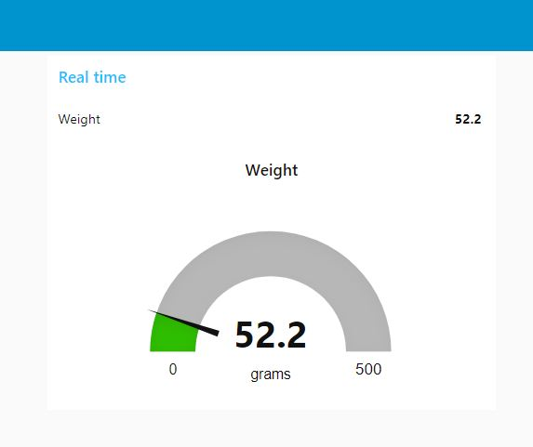
Deployment - Node-RED dashboard at Raspberry Pi

Slide 24
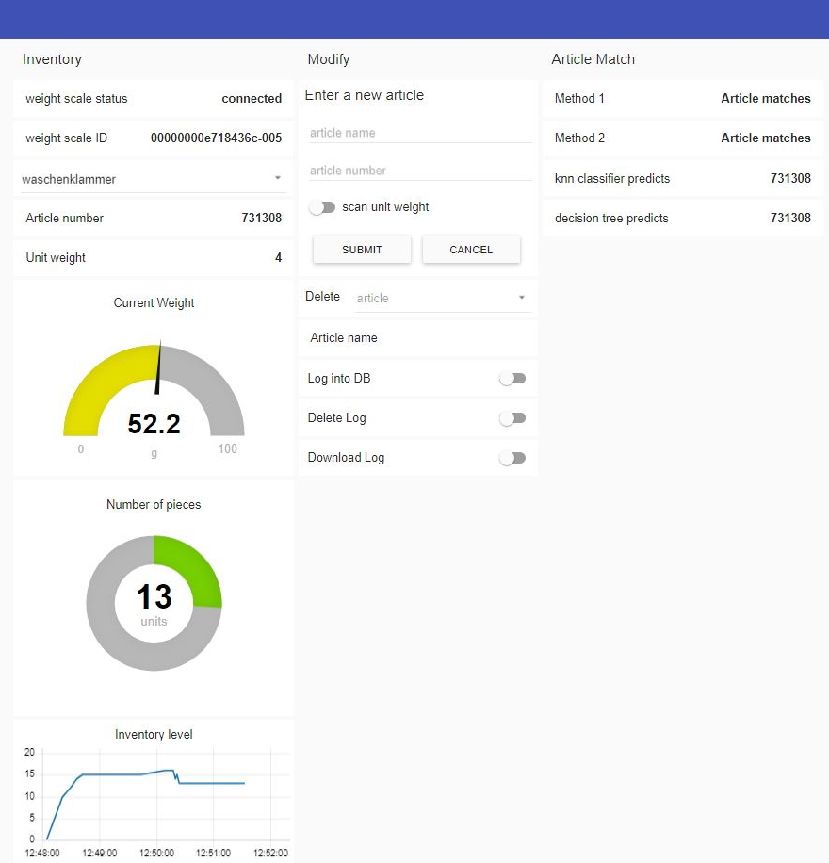
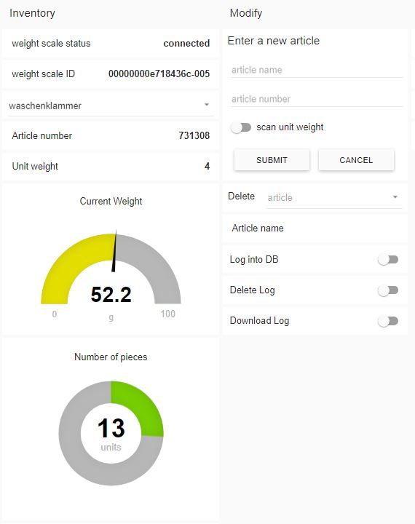
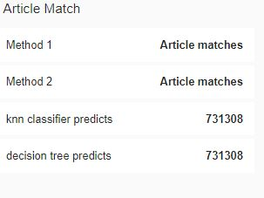
Deployment - Node-RED dashboard at local machine

Slide 25
Prospects - Scalability approaches I
1 weight scale - 1 raspberry Pi
weight scale + raspberry pi can be identified using scale id.
for each new pi, a new duplicate flow must be deployed at both pi and client end.
for each new flow, the MQTT node must be specified with it’s respective ip address.
Each flow has it’s own dashboard.
n weight scales > n raspberry pi > n flows at pi end > n flows at client end> n client dashboards > 1 distributed storage system

Slide 26
Prospects - Scalability approaches II
4 weight scale - 1 raspberry Pi
For each weight scales connected to pi, pi randomly allocates device numbers to it like e718436c-005, e718436c-006, e718436c-00X.
Can identify from which pi, the readings are being received but cannot identify from which connected weight scales, it is being sent.
Since a pi can have four weight scales connected to it, a single pi will have four node red flows for each of the weight scale
for each flow, the “serial in” node must be specified with corresponding serial port.
for all the four flows, the “MQTT” node should be having the same ip address.
A single flow at the client end for one pi with four weight scales sending weight readings.
One single dashboard at the client end.
For every new pi, the third step is to be repeated.
4n weight scales > n raspberry pi > 4 flows at each (1..n) pi > n flows at client end > n dashboards > 1 distributed storage system.
Note - Since there is only one dashboard at the client end for one raspberry pi which is connected to four weight scales, it may lead to synchronisation issues.

Slide 27
Thank you for your attention

